Slide 1

BE Development #1
Otniel Yosi Viktorisa
Product Developer Team Lead at PT. Altrovis Tekno Global
otniel.y.viktorisa@gmail.com

Slide 2
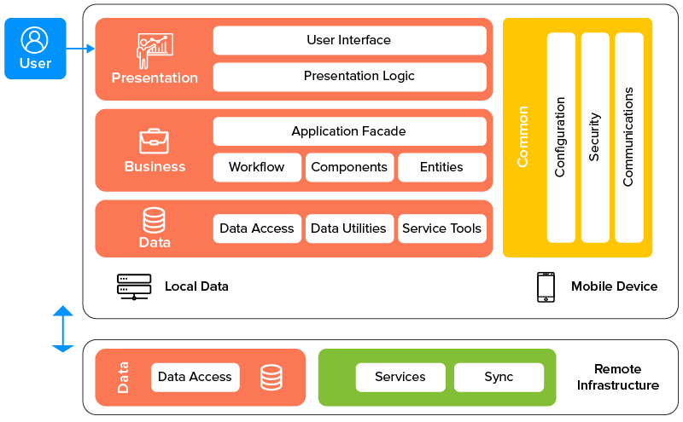
Layered architecture
Image:https://os-system.com/blog/mobile-app-architecture-how-to-design-it/

Slide 3
Implementation
Presentation Layer = Frontend --> mobile, web
Business Layer + Data Layer = Backend
Language : C#
Platform : .NET Core
Application Framework : ASP.NET Boilerplate
Persistence Framework : Entity Framework Core

Slide 4
.NET Core
Supported by Microsoft
Cross-platform

Slide 5
ASP.NET Boilerplate
Boilerplate = repetitive code
Free and open source
Provide basic functionalities (e.g. authentication, authorization)
Use best practice pattern
Easy to use but need time to master

Slide 6
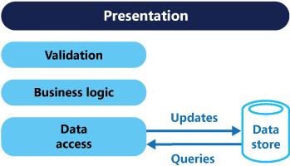
Entity framework
Persistence framework
Code-first
Schema-first
Image:https://docs.microsoft.com/en-us/azure/architecture/patterns/cqrs

Slide 7
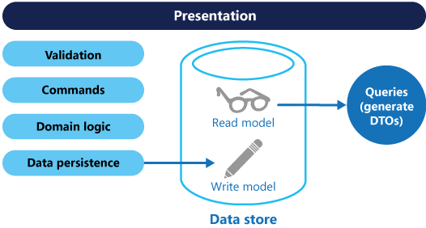
CQRS Pattern
Command and Query Responsibility Segregation
Mainly used in microservices
Image:https://docs.microsoft.com/en-us/azure/architecture/patterns/cqrs

